Slide 1
Lindsay high school Class of 2017
Anthony Delacruz

Slide 2
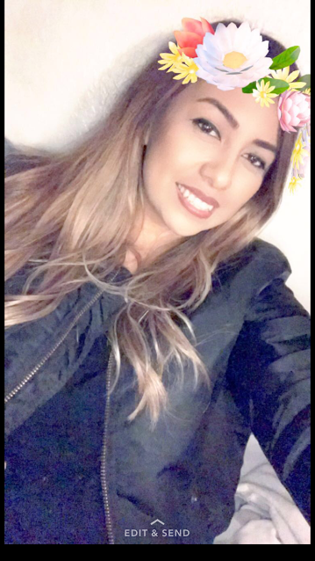
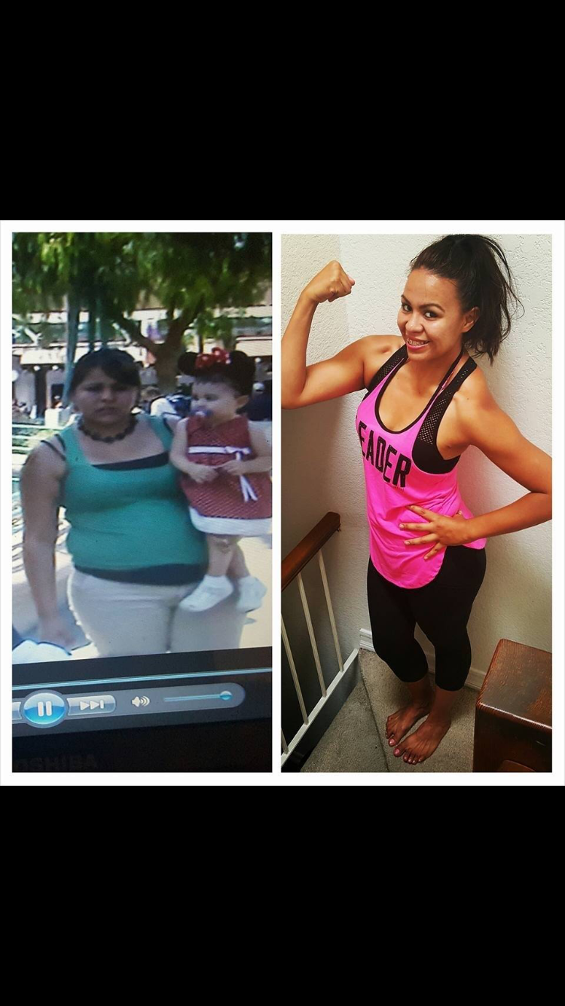
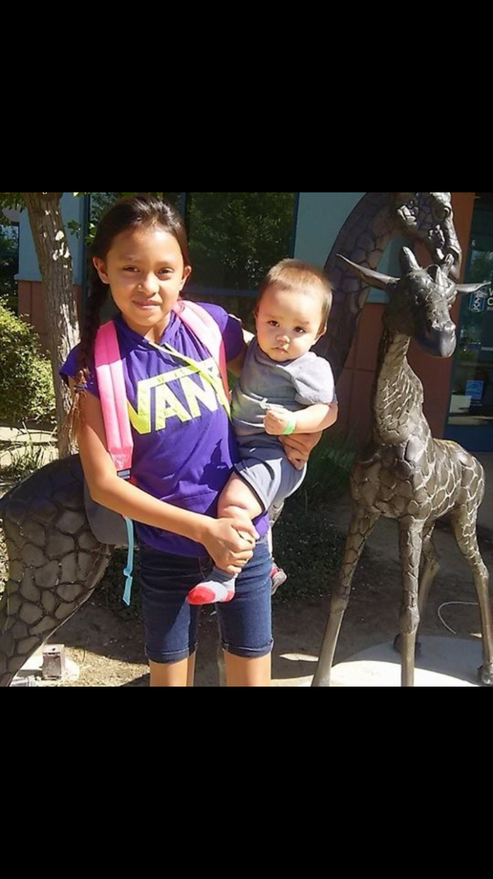
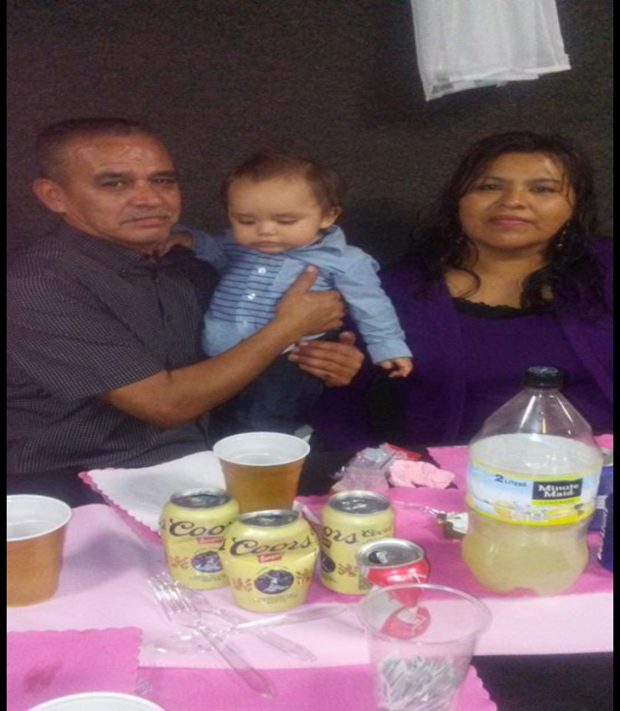
About Me
I come from a family of 6
I am the middle child
Born in Porterville
Something I struggled with was focusing in school

Slide 3
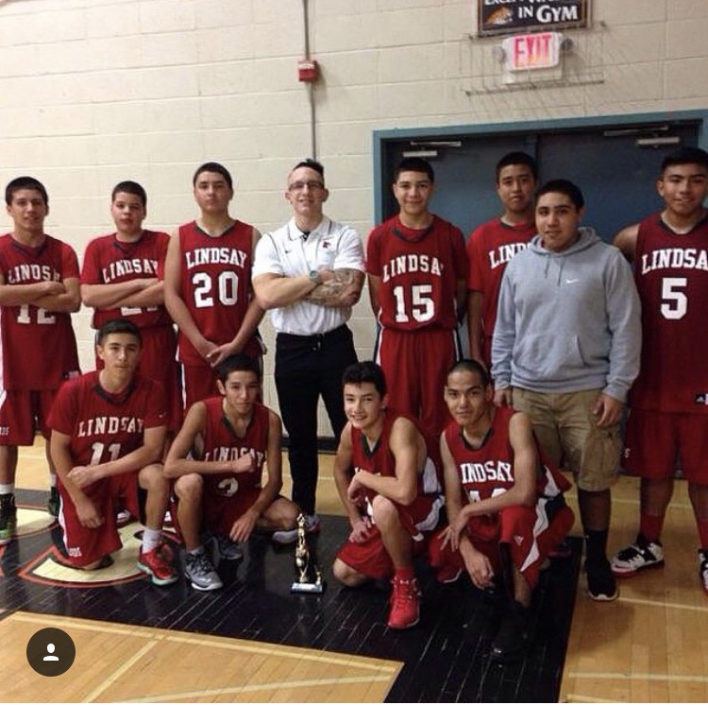
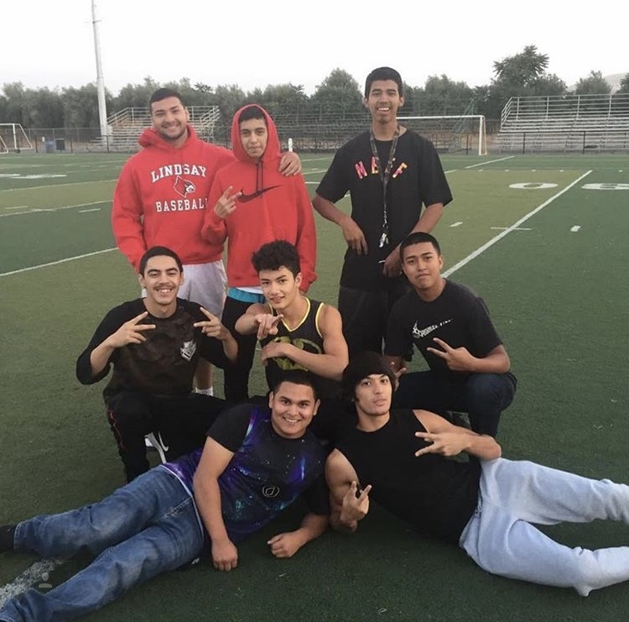
High school experience
High school was exciting
Basketball
Friends
Video Production

Slide 4
Job shadow
Assistant Nurse
Mariah Madrigal
Visalia Healthily Families
Experience

Slide 5
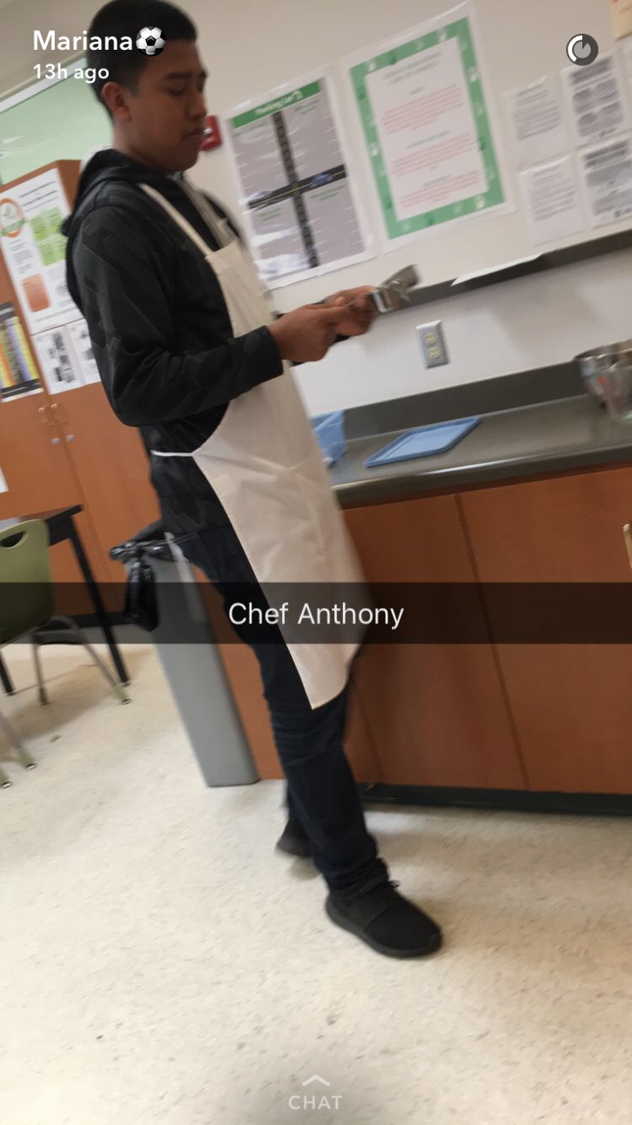
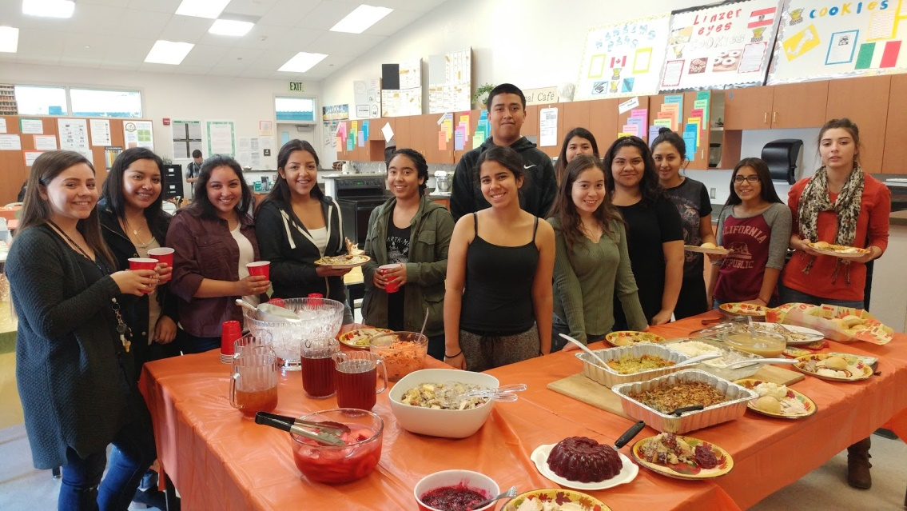
Pathway
Food Service and Hospitality
Correct way to use kitchen utensils
Does not relate to future career

Slide 6
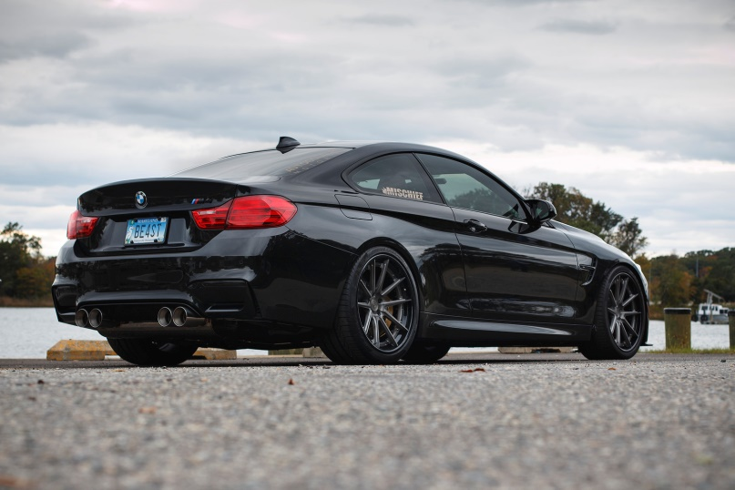
My future
Go to Saddle-Back college or Irvine Valley College
Work for BMW (as a mechanic)
10-15 years from now work for Mercedes Benz

Slide 7
LEAVING HIGH SCHOOL
Leaving high is kind of exciting and scary
Would be an honor

Slide 8
Questions ?
Questions ?

